Slide 1
Convex Hull Algorithms
Jarvis March & Graham Scan
Nabin Mulepati

Slide 2
What is Convex Hull?
The convex hull of a finite set of unique points Q, usually denoted as CH(Q), is the smallest convex polygon P such that all points in the set Q, which consists of at least three non-collinear points, are either in the interior of P or on the boundary of P.
In two dimensions, it is basically a polygon formed by tightly wrapping a thread around a set of needles on a board representing a set of points on a plane

Slide 3
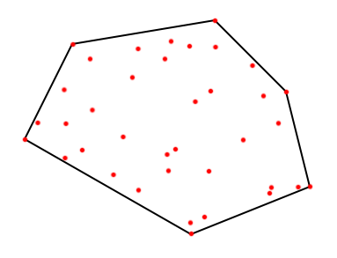
Convex hull of a set of 37 points.

Slide 4
Applications
Computer visualization (video games, etc)
Path finding (embedded AI of Mars mission rovers)
Geographical Information Systems (computing accessibility maps).
Visual pattern matching (e.g. detecting car license plates)
http://fleischer.selfip.com/Courses/Algorithms/Alg_ss_07w/Webprojects/Chen_hull/applications.htm

Slide 5
Jarvis March
Simpler of the two.
Has running time complexity of O(nh).
Worst case complexity of O(n²).
Generally faster than Graham scan.
Output sensitive Algorithm.
Much faster when the size of the hull is known to be small.
Very slow when the input points are distributed around/closer to the convex hull.

Slide 6
Jarvis March algorithm
p₀ is the extreme point with the minimum y-coordinate, or the leftmost point in case of a tie.
Minimum angle = infinity
do
for i=1 to the number of input points
1. if the angle A formed by the direction of the previous hull and the next point is smaller than the minimum angle, then minimum angle = A
end for
push the point that forms the minimum angle A into the convex hull
while next point in the convex hull is not equal to p₀

Slide 7
Graham Scan
Implementation is more complex than Jarvis march.
Has running time complexity of O(nlogn).
Running time is determined by the step that sorts the points according to the angle that the points make with the extreme point in CCW direction.
Generally slower than Jarvis march.
Faster when the input points are distributed around/closer to the convex hull.

Slide 8
Graham Scan algorithm
p₀ is the extreme point with the minimum y-coordinate, or the leftmost point in case of a tie.
p₁, p₂, …, pm are the remaining points in Q sorted by polar angle in counterclockwise order around p₀. If there is more than one point with the same angle, the point farthest from p₀ is selected.
Push p₀, p₁ and p₂ into an empty stack S.
for i = 3 to m
while the angle formed by the point[i], and the top two points in the stack makes a nonleft turn.
Pop the point on the top from the stack.
end while
Push p_{i} into the stack S.
return S

Slide 9
experiments & results

Slide 14
reference
Cormen, Thomas, Charles Leiserson, Ronald Rivest, and Clifford Stein. Introduction to Algorithms. Third. Cambridge: The MIT Press, 2009. 1029-46. Print.

Slide 15
Questions?

